Slide 1

Department of Information Technology presents PROJECT ON :- VIRTUAL TOURIST GUIDE
SSBT’s College Of Engineering and Technology, Bambhori, Jalgaon.
UNDER THE GUIDANCE OF :- DR. K. P. ADHIYA
PRESENTED BY:-
1) PIYUSH RAJKUMAR SAHU
2) RAHUL GOPAL PATIL
3) NARENDRA GOKUL PATIL
4) SAURAV RANJAN

Slide 2

VIRTUAL TOURIST GUIDE, HOW’S THIS POSSIBLE?
.

Slide 3
CONTENTS
INTRODUCTION AND PROBLEM STATEMENT
OBJECTIVES OF THE PROJECT
MOTIVATION
DESIGN
OUTPUTS
SYSTEM REQUIREMNTS
CONCLUSION

Slide 4
ABSTRACT
Our project “Virtual Tourist Guide” is meant to be useful for facing challenges such as Lack of proper infrastructure, lack of skilled human resources, insufficient promotion and marketing, taxation, security issues, etc. efficiently and will be a safe and best alternative for the tourists to choose without any doubts or hesitation. From source to destination, our virtual tourist guide will be there for the tourists to help and to answer their every question. Though government has many tourism websites but they are not to be meant as user friendly as our website will be. The basic aim of this project is to provide hassle-free service to the tourists travelling at any particular place.

Slide 5
PROBLEM STATEMENT
PROBLEM STATEMENT - The reason behind developing this project is problems such as lack of proper infrastructure, lack of qualified human resource, insufficient promotion and marketing, taxation, security issues etc. Governmental efforts have also been insufficient to create a better option. This section must be treated with caution in order to give a simple and powerful solution to this problem else it will fail to justify this research. To overcome these challenges, the main factor is to study the consumer behaviour that deals with the potential customers, and tourism that deals with the requirements of the consumer. Our project will try to provide each and every type of experience to the user and will try to meet their expectations.

Slide 6
INTRODUCTION
INTRODUCTION - Virtual Tourist Guide is developed by using python for desktop application and HTML, CSS and another frameworks for web development. It is developed by planning and project decision to guide the new tourist. This research has led to development of decision guide as a tool for practitioner to reach balance decision for enhancing travelling capacity.
This project supports some research efforts by developing a blueprint for visioning linked closely to the decision guide. The objective of project is to providing the information about tourism and places with appropriate guidance.

Slide 7
OBJECTIVES
OBJECTIVES -The overall objective of the project Information are as follows:
1) Provide security for securing users data.
2) Guide the tourist virtually avoiding the risk like direct travelling without any guidance.
3) To save the time and money of the tourists being efficient in every term.
4) Will provide appropriate information about their destination places.
5) Will be able to avoid fraudsters and scammers .
6) Showing the important things to carry during the tours.

Slide 8
MOTIVATION
MOTIVATION :- For many people, tourism is a way of satisfying their psychological needs such as travelling, performing leisure activities, exploring novelty and capabilities, self-expression and self-assurance, creativity, competition, need for relaxation, and belongingness. The intrinsic motivations pertain to assuring one’s capabilities on different emotional fronts. Intrinsic motivation drives the tourists to opt for tourism for intangible rewards such as fun, assurance, and other emotional needs.

Slide 9
DESIGN
STATE CHART:-
In this part we will get to see the design of the project
interaction part, roles given to the admin and user and various
parts of the project explained with the help of the USE CASE diagram shown below:-

Slide 10
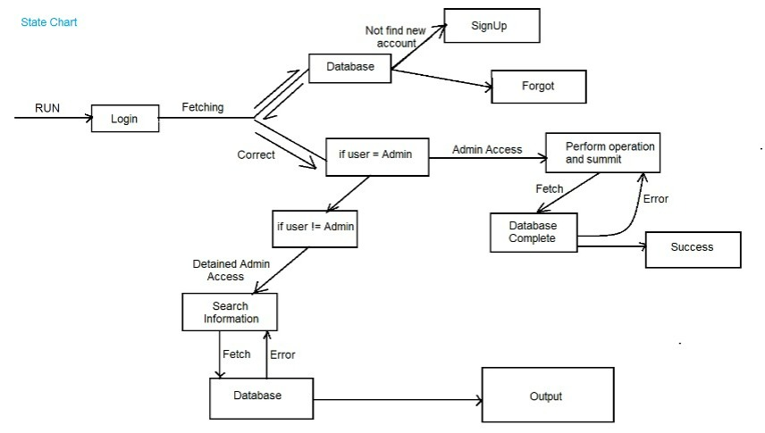
STATE DIAGRAM/CHART

Slide 11
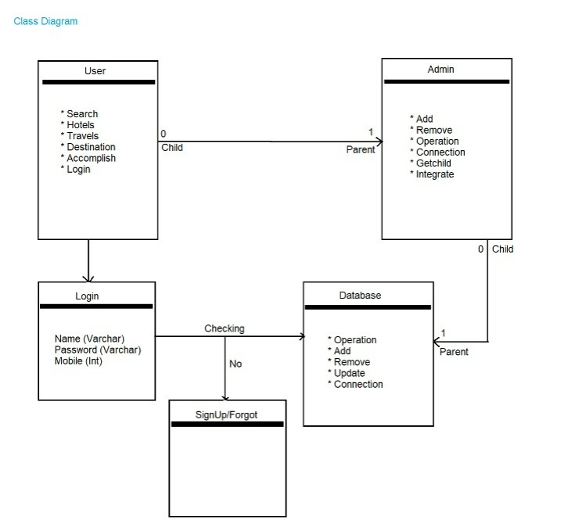
Class Diagram

Slide 12
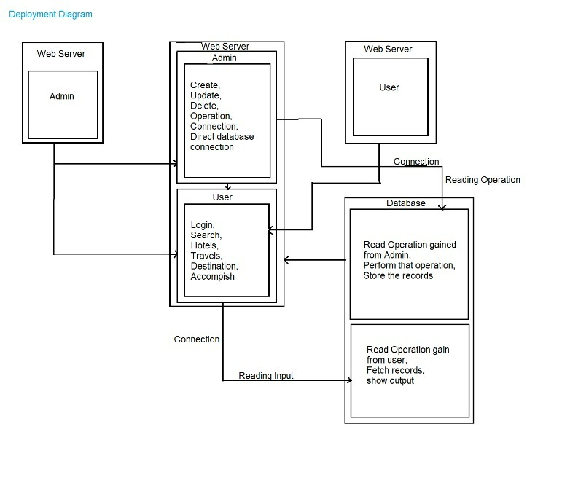
Deployment Diagram

Slide 13
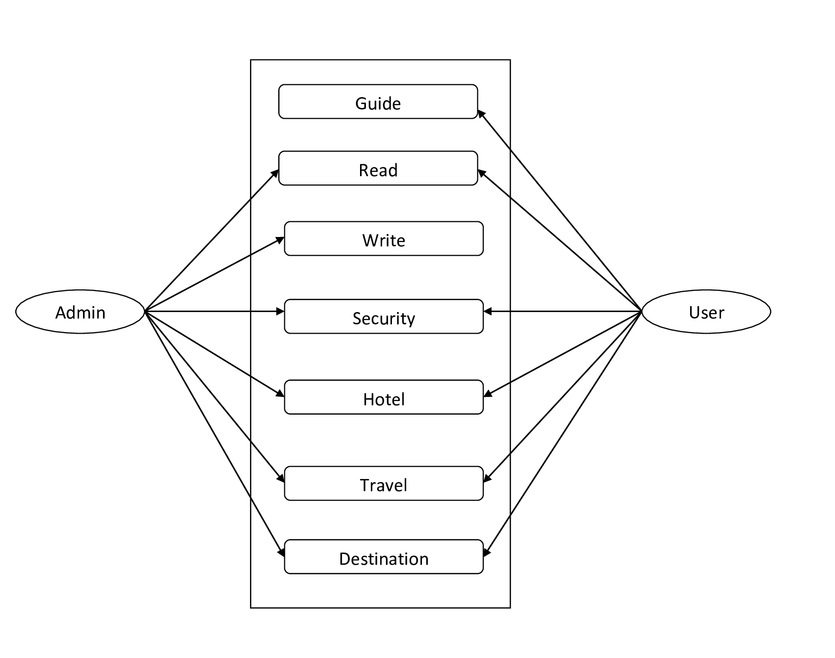
Used-case Diagram

Slide 14
SYSTEM REQUIREMENTS
1.HARDWARE REQUIREMENTS:-
Intel i3 processor based computer or higher .
RAM:-4gb ( minimum)
Storage:-10GB(minimum)
2.SOFTWARE REQUIREMENTS:-
Windows 7 or higher
Google Chrome browser
3. Languages used :-
Front end :- HTML , CSS , JAVASCRIPT , BOOTSTRAP, PYTHON (TKINNT MODULE)
Backend:- PHP , MYSQL

Slide 15
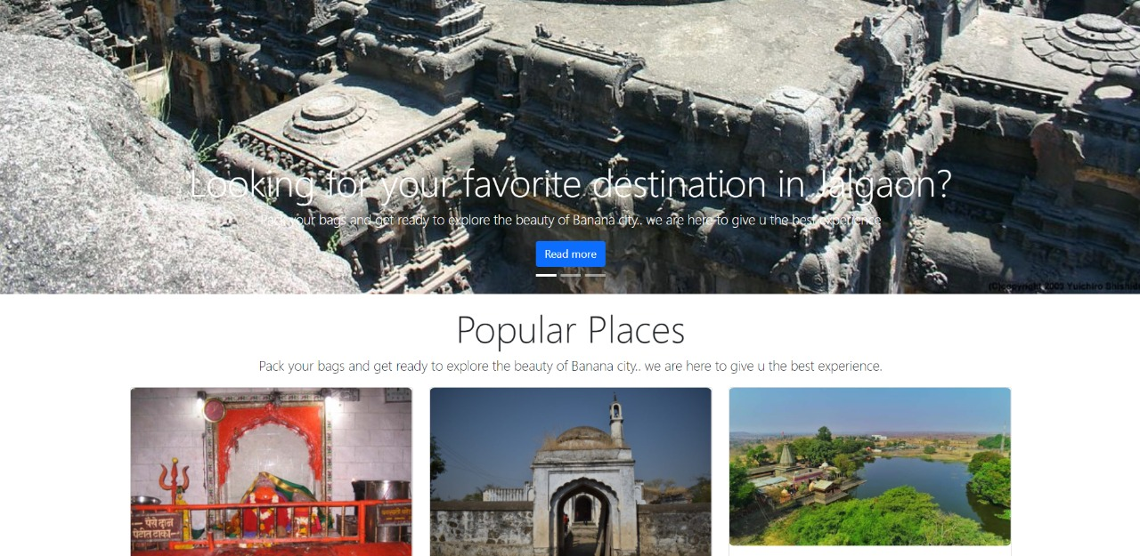
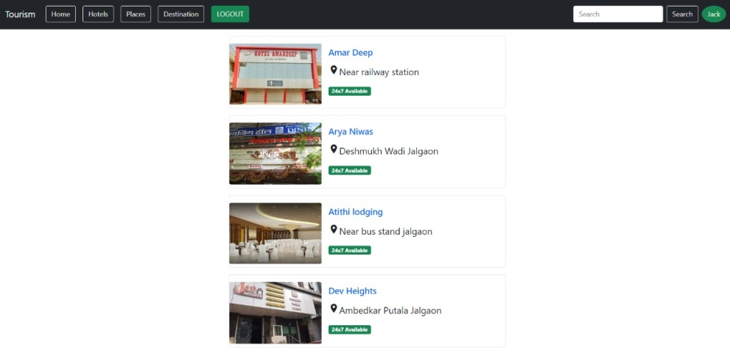
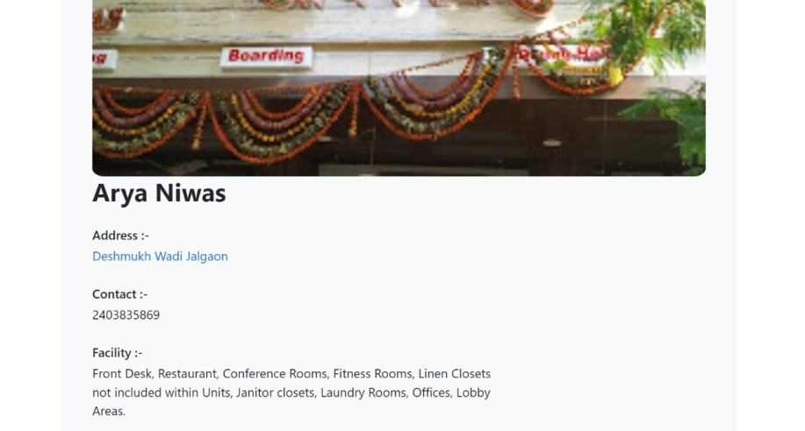
OUTPUTS

Slide 16
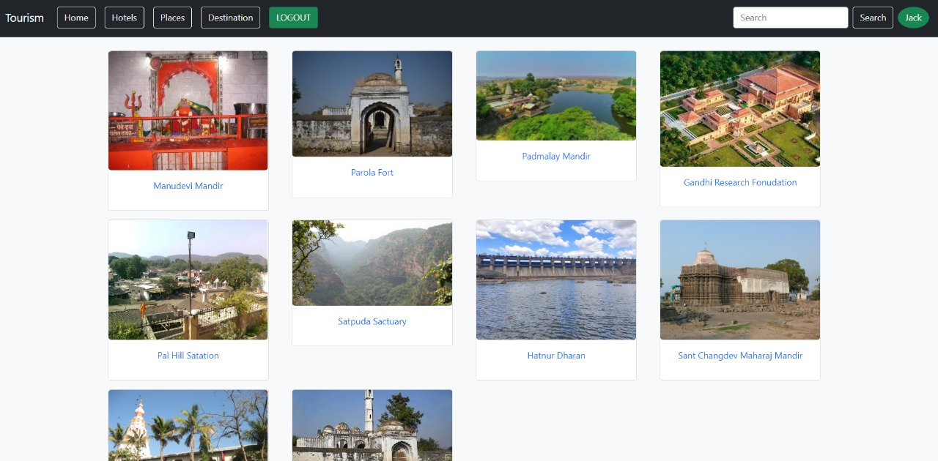
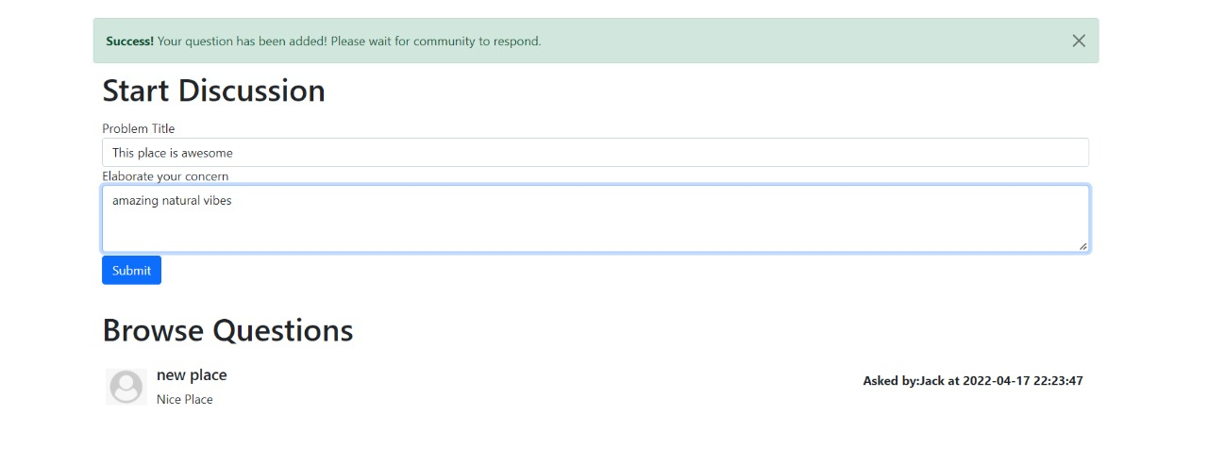
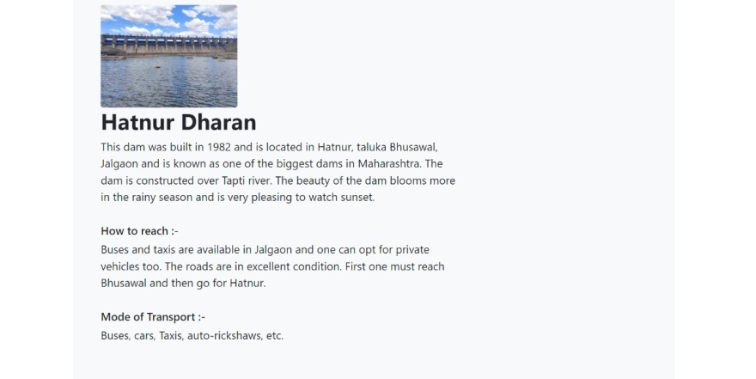
OUTPUTS

Slide 17
CONCLUSION
Consumer behavior towards the tourism depends on various factors and the main aim of this project is focused on this aspects and a detailed evaluation is done against this key aspect to understand the consumer behavior towards choosing a particular place as the tourism destination. The required primary source of information is gathered from various types of tourism websites and research papers including the experiments done to find out the problems which are currently present in the tourism industry.

Slide 18
REFERENCES
Growth and performance of tourism in India by Vijay M. Kumbhar, from DGC college of commerce , Satara.
International Journal Of Tourism Research.
Sustainable Tourism Research by S K Nepal 2009.
New tourism Research by J Tribe 2005.
Towards innovation and sustainable tourism Research
by L Ruhanen, B Weiler , B D moyale

